Slide 1

Flyzy Flight Analysis
By: Shiv Narayan Soni

Slide 2
Factors Affecting Flight Ticket Prices
Demand
Booking Time
Route & Distance
Airline Competition
Class Of Service
Number of Stops
Duration

Slide 3
Data Analysis
Connecting Data Source and Cleaning Data
In Power BI analysis of Flyzy Flight Analysis, I have taken the first step of acquiring the data and performed some basic data cleaning by removing an unnecessary index column from the dataset.
Creating measures in Power BI is an important step in data analysis, by calculating the average duration and price, we can gain insights into the typical flight duration and pricing trends of Flyzy flights.
Overall, by performing basic data cleaning and aggregation.

Slide 4
Exploratory Data Analysis
I have taken the first step of getting the data into Power Bi and performed some basic cleaning by removing an unnecessary index column from the dataset.
Creating measures in Power Bi is an important step in data analysis, by calculating the outliers we can get insights into the typical flights and pricing trends of Flyzy flights.
Identifying patterns, trends, and relationships between variable.
Find distribution of flight ticket and average flight ticket by airlines.

Slide 5
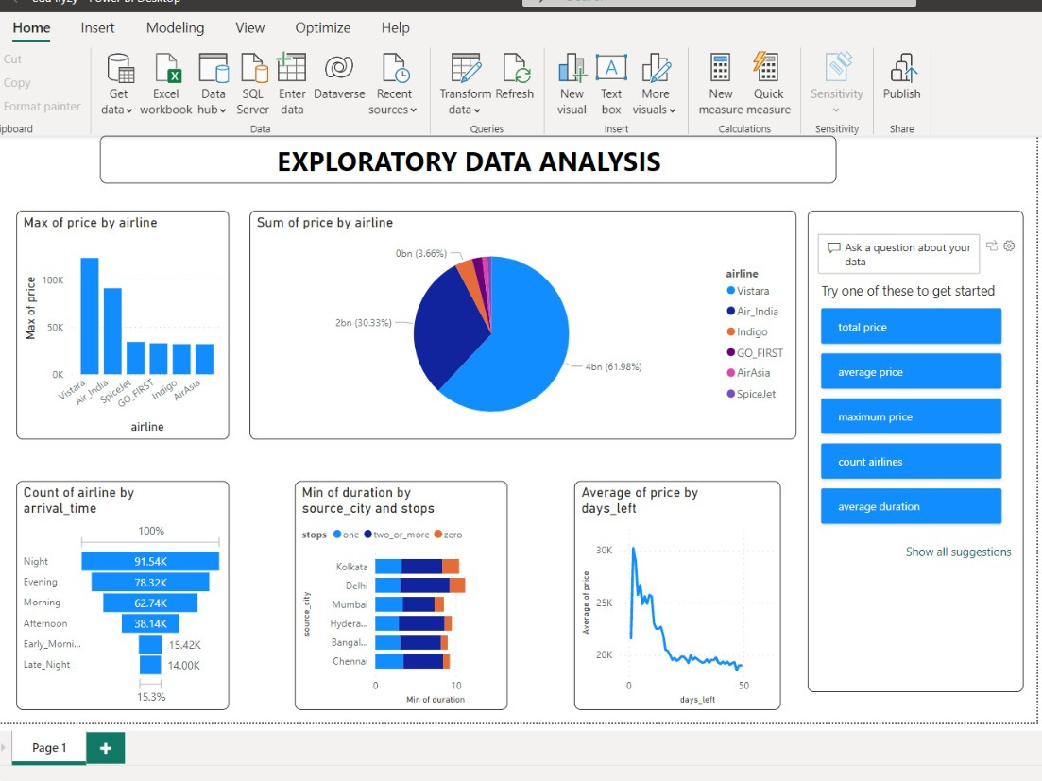

Slide 6
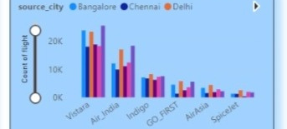
Data Insights and Visualizations
Number of flight by airlines and destination city:
The destination and flight route also affect ticket prices. Flights to popular destinations, such as Mumbai, Delhi, or Bangalore, are typically more expensive than flights to less popular destinations. Similarly, direct flights are generally more expensive than connecting flights.

Slide 7
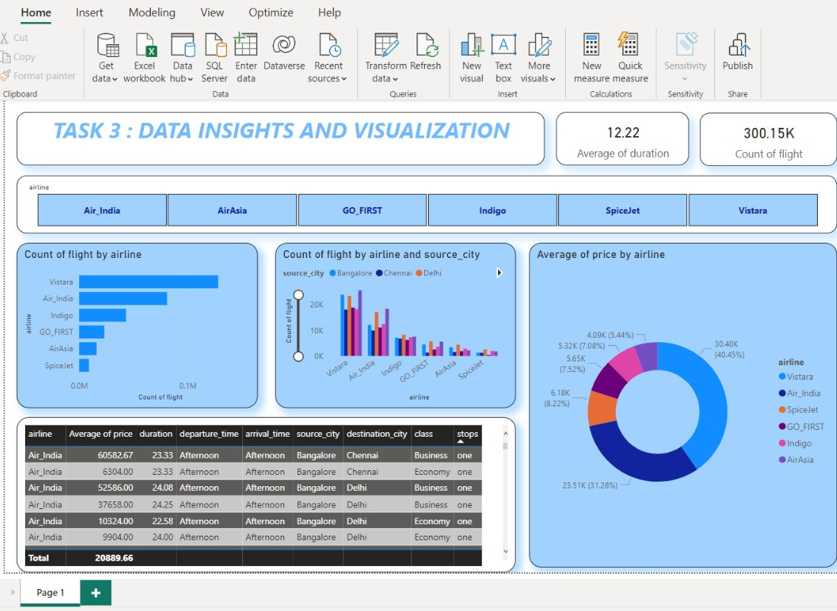

Slide 8
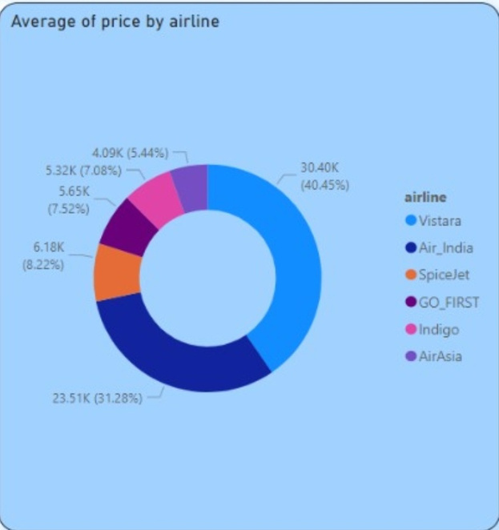
Data Insights and Visualizations
Average flight ticket price by airline:
The donut chart below shows the average flight ticket price for each airline for a one-way ticket.
The data shows that Indigo offers the lowest Average ticket price, at 4.09K.
Air Asia and Go-First Airlines also offer relatively low minimum price.
It is important to note that these are minimum prices and actual ticket prices may vary depending on various factors such as the days left, time of travel, advance booking, and availability.
Notes:
7

Slide 9
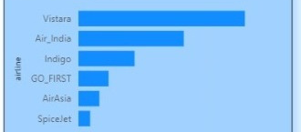
Count of flight by airline
Count of flight by airlines shows that vistara and Airindia have the highest number of airlines
Where as a AirAsia and spice jet have least number of flight

Slide 10
Conclusion
In conclusion, the results of our analysis highlight the importance of understanding
the various factors that impact flight ticket prices. By considering these factors,
travelers can make informed decisions when booking flights, and airlines can
develop effective pricing strategies. It is essential to stay updated with these
factors and their impact on flight ticket prices to make informed choices and
achieve cost-effective travel.

Slide 11
Thank You

